Slide 1
Texas Community Development Block Grant Program
TDA-GO Overview

Slide 2
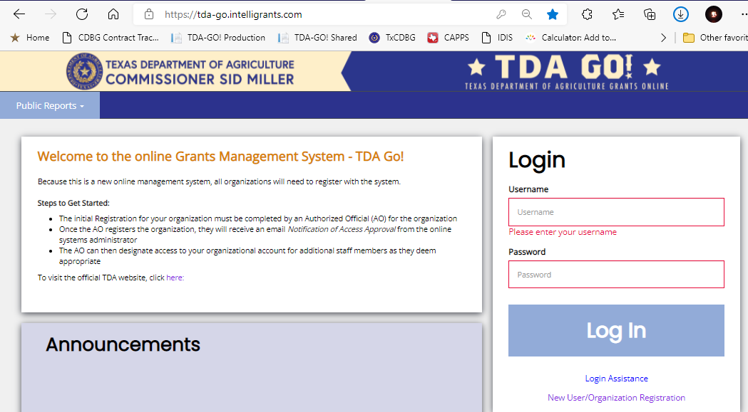
TDA- Grants Online
Online grant management system
Accessible from anywhere
https://tda-go.intelligrants.com
Notes:
The system is entirely online and is accessible from any computer with an internet connection. Accessibility for tablets is coming soon!

Slide 3
TDA- Grants Online
Currently, TDA will house applications for the following programs:
Texas CDBG
Home Delivered Meals
Marketing Enhancement Assistance Grant
Rural Health Grants
Seafood Processors Recovery Grant
Specialty Crop Block Grant
State of Texas Agricultural Relief grants
State Trade Expansion Program
Young Farmer Grant
Notes:
The TDA-GO system will be used for nearly all grants issued by TDA’s Trade and Business division.

Slide 4
TDA-GO References
Resources for navigating the TDA-GO system can be found on the TDA website:
Open Grants page
TxCDBG Implementation Manual page
TxCDBG Training page
Notes:
You can access your profile by clicking your name in the top right corner of the screen.

Slide 5
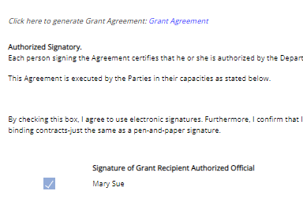
TxCDBG
Grant Agreement Certification
Applications are signed and submitted within the system
If awarded, grant agreements are executed within the system

Slide 6
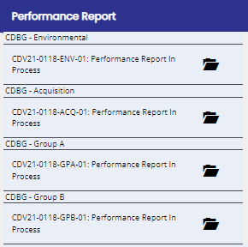
TxCDBG Grant Management
Once awarded, all reporting and grant management tasks will take place within the system.
Email for technical assistance
Notes:
After the award, the system will continue to be the primary method of collecting information. We will not expect reports or standard forms to be submitted via email. But of course TDA staff remain available by email and phone for technical assistance with your grant.

Slide 7
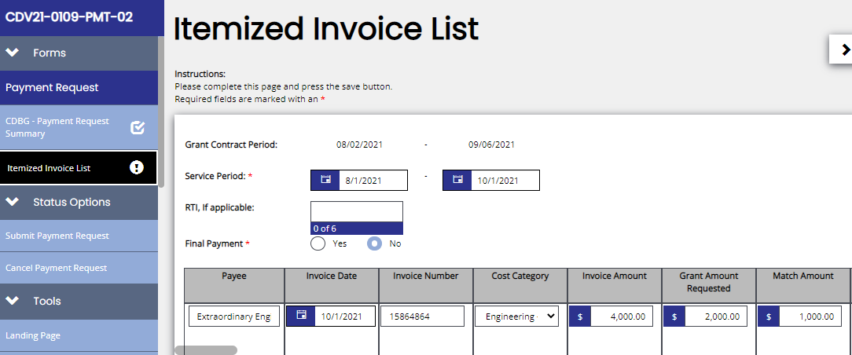
TxCDBG Grant Payment
Grant payments will be submitted and processed within the system.
Direct Deposit information must be submitted separately.
Notes:
Grant payments are also handled entirely within the system. Grant Recipients can log in to check the status of each payment.
Please note: banking information is NOT collected through the TDA-GO system. You must submit this information to TDA separately as directed by staff. For CDBG, submit to CDBGReporting@Texasagriculture.gov.

Slide 8
For Questions or Technical Assistance
Assistance with Applications:
tda-go@texasagriculture.gov
Assistance with Technology:
azhelpdesk@agatesoftware.com

